Slide 1
Naïve Bayes
& Classification

Slide 2
01
Introduction

Slide 3
What is Classification in Data Mining?
Classification in data mining is a supervised learning technique used to categorize or classify items into predefined classes or groups. The goal is to learn a mapping function from a set of labeled training data, where each data point is associated with a class label, to make predictions or classifications for new, unseen data.
What is Naïve Bayes algorithm?
a probabilistic machine learning algorithm that is commonly used for classification tasks. It is based on Bayes' theorem, which is a mathematical formula that calculates the probability of a hypothesis given the observed evidence. The "naïve" aspect of the algorithm comes from the assumption that features used to describe instances are conditionally independent

Slide 4
02
Naïve Bayes algorithm

Slide 5
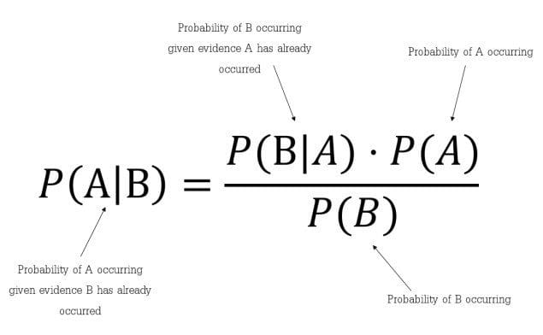
Bayes' Theorem is a fundamental concept in probability theory that describes the probability of an event based on prior knowledge of conditions related to the event. ​
Bayes Theorem

Slide 6
03
How it Works?

Slide 7
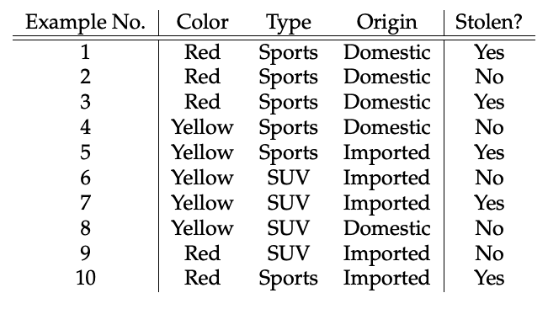
The dataset is represented as below.

Slide 8
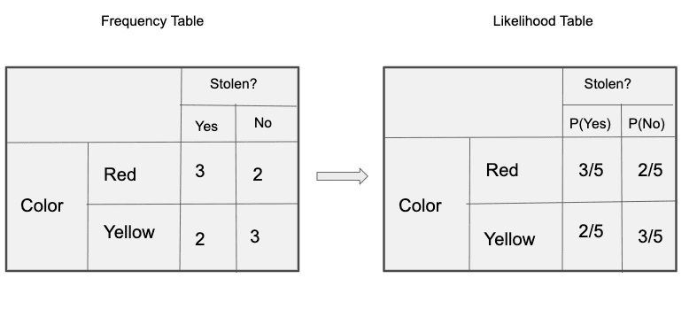
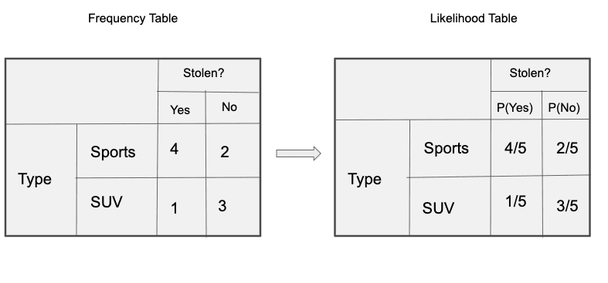
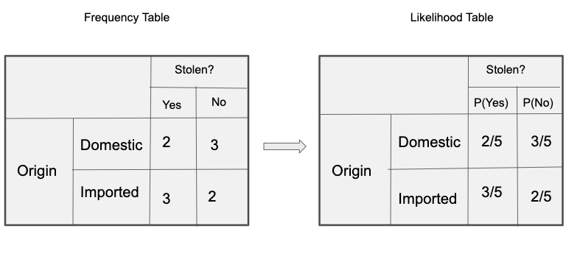
The posterior probability P(y|X) can be calculated by first, creating a Frequency Table for each attribute against the target. Then, molding the frequency tables to Likelihood Tables

Slide 9

and finally, use the Naïve Bayesian equation to calculate the posterior probability for each class.
P(Yes|x) = P(Red|Yes) * P(SUV|Yes) * P(Domestic|Yes) * P(Yes)= 3/5 * 1/5 * 1/2 = 0.072
P(No|x) = P(Red|No) * P(SUV|No) * P(Domestic|No) * P(No)= 2/5 * 3/5 * 3/5 * 1/2 = 0.024
P(Yes|x) > P(No|x) So the result of stolen is “Yes”

